Slide 1
NHẬP MÔN ỨNG DỤNG DI ĐỘNG
BUỔI 2 CÁC CÁCH TIẾP CẬN PHÁT TRIỂN ỨNG DỤNG DI ĐỘNG
GVGD: ThS. Huỳnh Tuấn Anh

Slide 2
OUTLINE
Native app development
Hybrid app development
Cross-platform app development
Progressive web app
NoCode
Notes:
Cross-platform development is trending technology in the mobile app market. People want quality along with time-efficiency and effort-reduction which can be achieved by undertaking cross-platform development where you can make apps similar to native applications using the same codebase.

Slide 3
1.1 Native app development
Going native is the way most product owners dream of
high performance
tailored-to-the-platform UX
But:
fits one platform only
Java or since recently Kotlin for Android, and Swift/Objective-C for iOS
cost-consuming => the cost is the key distinction of native vs. hybrid app development
Wide marketplace or making the profit
Notes:
Going native is the way most product owners dream of, but not all can afford. It involves the creation of a mobile app that fits one platform only. In this case, engineers leverage a native-to-the-operating-system programming language. It can be Java or since recently Kotlin for Android, and Swift/Objective-C for iOS. Users love native apps for high performance and tailored-to-the-platform UX. This approach, though, scares off startupers for being cost-consuming. And the cost is the key distinction of native vs. hybrid app development.

Slide 4
1.2 Native app development
Engineers get access to the device’s full feature set
memory management
complex networking
The biggest challenge is:
run the app on two or more platforms
need to make separate codebases
Notes:
For development, engineers get access to the device’s full feature set. This allows them to leverage advanced functionalities (memory management, complex networking, etc.). But, the biggest challenge is to run the app on two platforms. To do this, you need to make separate codebases. Yet, some native extensions enable code sharing. For example, you can share the C++ libraries between iOS and Android apps using Java Native Interface. Even so, product owners are desperate to increase development costs almost twofold.

Slide 5
1.3 Native app development
Native Apps Have The Best Performance
Native Apps Are More Secure
Native Apps Are More Interactive And Intuitive
Native Apps Allow Developers to Access the Full Feature Set of Devices
Native App Development Tends to Have Fewer Bugs During Development
Notes:
1. Native Apps Have The Best Performance
With native mobile app development, the app is created and optimized for a specific platform. As a result, the app demonstrates an extremely high level of performance. Native apps are very fast and responsive because they are built for that specific platform and are compiled using platforms core programming language and APIs. As a result, the app is much more efficient. The device stores the app allowing the software to leverage the device’s processing speed. As users navigate through a native mobile app, the contents and visual elements are already stored on their phone which means load times are quick.
Clearbridge Android Developer Katie Liu says, “with a native app, it’s not only the coding language that’s native, but also the architect and UX. If the app is designed to perform the way the platform expects it to, the performance will always be superior.”
2. Native Apps Are More Secure
Web apps rely on different browsers and underlying technologies such as JavaScript, HTML5, and CSS. Developing a native mobile app is a great way to guarantee your users reliable data protection.
3. Native Apps Are More Interactive And Intuitive
Native mobile apps run much smoother regarding user input and output. These types of apps inherit their devices’ OS interfaces, making them look and feel like an integrated part of the device.
The most advantageous benefit to native mobile apps is the superior user experience. Native apps are created specifically for an operating system. They stick to the guidelines that ultimately enhance and align the user experience with the specific operating system. As a result, the flow of the app is more natural as they have specific UI standards for each platform. This allows the user to learn the app, such as deleting an element quickly. Adhering to specific guidelines eliminates the learning curve and allows users to interact with apps using actions and gestures they’re familiar with already.
4. Native Apps Allow Developers to Access the Full Feature Set of Devices
Native apps are developed for their particular platform, taking full advantage of the software and the operating systems’ features. These apps can directly access the hardware of the device such as the GPS, camera, microphone, etc. so they are faster in execution, which ultimately results in better user experience. Push notifications are another huge advantage to choosing native app development. Push notifications go through the iOS server (APNS) which you need your app bundle ID and same with Google’s Cloud Messaging (GCM).
5. Native App Development Tends to Have Fewer Bugs During Development
It’s much more difficult to maintain two different applications in one codebase than it is two applications in two codebases. With native app development, you have fewer dependencies for bugs to occur because you’re not relying on a cross-platform tool such as Xamarin or Cordova. Hybrid apps access hardware through a bridge which often slows development down and can amount to a frustrating user experience.
This problem is prominent when new versions of Android and iOS are released. Native app developers have access to new software development kits (SDK) to start building their applications with the most recent features. Because of this lead time, users of native applications have access to new platform features once they update the operating system.
Clearbridge Mobile’s Developer, Ronak Shastri further explains the issue of working with hybrid approaches. He argues the disadvantage of having to wait for the third-party developer of the hybrid tool to implement the bridge to new operating system features. “With hybrid app development, we are dependent on a cross-platform development tool such as Xamarin or Cordova. Every time new features are released in the UI kit, we need to wait for the tool to support it. When you develop a hybrid app, there’s an added layer that you don’t have control over which can increase the chances of bugs occurring.” He explains that bugs are a huge concern for hybrid app development when working with the latest features that have been released for a particular operating system. This is an essential and often overlooked part of generating loyalty among users.

Slide 6
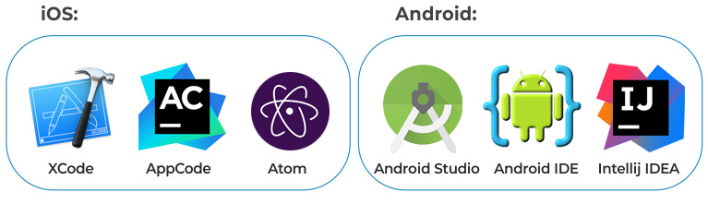
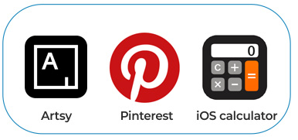
1.4 Native app development
Tools to use:
Examples:

Slide 7
1.4 Native app development
Android (Java)
JAVA is one of the most sought-after programming languages which offer a vibrant spectrum of features.
JAVA is contemplated to be the best language for Android development.
What makes JAVA dynamic is the object-oriented paradigm which it follows.
Flexibility, versatility, portability, and platform-independence are some of the traits which work in support of JAVA.
It works well for cross-platform app development as well. It also has efficient open-source development tools.
Notes:
https://source.android.com/setup/start/faqs

Slide 8
1.4 Native app development
Kotlin
Kotlin is a statically typed programming language that was developed to overrule the shortcomings of JAVA for Android app development.
Kotlin can be used in combination with JAVA to make more efficient and high-performance apps.
Kotlin has very clean syntax and simple code. It is interoperable and versatile.
It generates compact and cleaner code as compared to JAVA. Thus, it is the most popular language used for Android application development.

Slide 9
1.4 Native app development
Swift
Swift is majorly used for iOS app development.
Swift, later on, was made open-source by Apple and was made available for the developer’s community
Writing Swift code is interactive and fun, the syntax is concise yet expressive
Swift includes modern features developers love
Swift code is safe by design, yet also produces software that runs lightning-fast
Swift UI offers multiple features to add seamless design to your applications
Notes:
Swift
Swift is majorly used for iOS app development. Before the advent of native application development, Swift retained a monopoly in the iOS app development business but then Objective-C came into the picture, which was not that efficient and eventually was ruled-out by Swift.
Swift, later on, was made open-source by Apple and was made available for the developer’s community. According to the official documentation, Swift is a powerful and intuitive programming language for macOS, iOS, watchOS, tvOS and beyond. Writing Swift code is interactive and fun, the syntax is concise yet expressive, and Swift includes modern features developers love. Swift code is safe by design, yet also produces software that runs lightning-fast. Swift UI offers multiple features to add seamless design to your applications.

Slide 10
2.1 Hybrid app development
Hybrid app is cheaper alternative
Less time for development
Code sharing
Web technologies (HTML, CSS, JavaScript)
The reverse side of the coin:
sluggish performance
suboptimal user experience
Notes:
Native is not a must for the mobile experience. Besides, your project might need another vector of priority like a fast time to market. To this effect, a hybrid app is not just a cheaper alternative. It requires less time for development and allows for code sharing. The reverse side of the coin is sluggish performance and suboptimal user experience. Theoretically, it is possible to achieve a great UX and navigation patterns from a visual standpoint. This is, however, a challenge to put into practice.
Hybrid apps blend web elements with mobile ones. So, you create a codebase using standard web technologies (HTML, CSS, JavaScript). Then, you wrap it inside a native container – the WebView. The content within WebView is rendered as a plain old website. It is responsible for UX and access to the hardware functionality (camera, GPS, etc.). The latter, however, is quite limited in contexts of hybrid application development vs. native application development. Eventually, a user can get a standalone application in the app store.

Slide 11
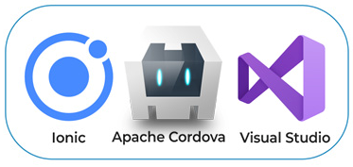
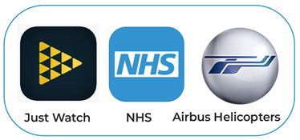
2.2 Hybrid app development
Tools to use:
Examples:
Notes:
Ionic
Ionic is an open-source framework that is used to build cross-platform mobile app development. According to the official ionic docs, Ionic Framework is an open-source UI toolkit for building performant, high-quality mobile and desktop apps using web technologies — HTML, CSS, and JavaScript — with integrations for popular frameworks like Angular and React.
Ionic is the perfect choice for hybrid mobile app development. It is an open-source SDK that uses platform-specific UI. Ionic is the only mobile app stack that enables web developers to build apps for all major app stores and the mobile web from a single codebase.

Slide 12
3.1 Cross-platform app development
Hybrid and cross-platform apps are not the same
The only common feature between them is code shareability
They both allow you to speed up the pipeline
Approaches
uses a native rendering engine
The codebase written in JS connects to native components via the so-called bridges
Advantages
seamless functionality
easy implementation
cost-effective production
Notes:
It is important to remember that hybrid and cross-platform apps are not the same. Perhaps, the only common feature between them is code shareability. Due to that, they both allow you to speed up the pipeline. All the rest discloses many differences between cross-platform vs. hybrid app development.
Cross-platform dev approach uses a native rendering engine. The codebase written in JS connects to native components via the so-called bridges. This provides the close-to-native UX. Cross-platform apps are free of platform hook. They offer seamless functionality, easy implementation, and cost-effective production. Yet, do not expect outstanding performance. Customization is also a pain since it is limited to the framework you use.

Slide 13
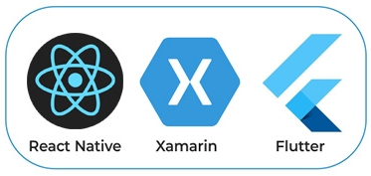
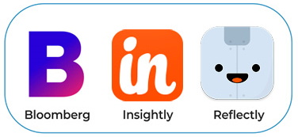
3.2 Cross-platform app development
Tools to use:
Examples:
Notes:
Videos demo

Slide 14
3.2 Cross-platform app development
React Native (Javascript)
React Native is a Javascript-based framework which is extensively used for cross-platform mobile app development.
It uses the same UI components as native iOS or Android apps. React native apps are functionally similar to other native apps builds independently.
It is an open-source framework that has a vast technology-driven community. React Native offer code reusability and helps in building faster and inexpensive applications. Cross-platform development helps save time and coding overheads.
Notes:
React Native (Javascript)
Javascript is called the cockroach of the IT industry. Just like a cockroach, Javascript is expected to never die, if not sooner than later. React Native is a Javascript-based framework which is extensively used for cross-platform mobile app development. It uses the same UI components as native iOS or Android apps. React native apps are functionally similar to other native apps builds independently.
It is an open-source framework that has a vast technology-driven community. React Native offer code reusability and helps in building faster and inexpensive applications. Cross-platform development helps save time and coding overheads.

Slide 15
3.2 Cross-platform app development
Dart
Dart is a fast, object-oriented paradigm based, programming language that is used for cross-platform app development. You can use Dart to write simple code snippets and fully-functional applications. Dart has a solution for almost everything under the sun right from desktop app development to web-app, mobile apps, command-line script, and server-side scripting.
Dart comes with a flexible compiler technology enabling you to run your code and build as per the target requirement. Dart equips us with a mobile app development framework called Flutter, which we will be discussing later in this article.
Notes:
Dart
Dart is a fast, object-oriented paradigm based, programming language that is used for cross-platform app development. You can use Dart to write simple code snippets and fully-functional applications. Dart has a solution for almost everything under the sun right from desktop app development to web-app, mobile apps, command-line script, and server-side scripting.
Dart comes with a flexible compiler technology enabling you to run your code and build as per the target requirement. Dart equips us with a mobile app development framework called Flutter, which we will be discussing later in this article.

Slide 16
3.2 Cross-platform app development
Flutter
Flutter is a cross-platform development framework based on Dart programming language. It was developed by Google. Flutter equips us with tools to build iOS as well as Android apps using a single codebase.
Flutter is a great alternative for the numberless Javascript based frameworks that change every day. Also, the applications based on Flutter are almost identical to the native iOS/Android apps in terms of look & feel.
Notes:
Flutter
Flutter is a cross-platform development framework based on Dart programming language. It was developed by Google. Flutter equips us with tools to build iOS as well as Android apps using a single codebase.
Flutter is a great alternative for the numberless Javascript based frameworks that change every day. Also, the applications based on Flutter are almost identical to the native iOS/Android apps in terms of look & feel.

Slide 17
3.2 Cross-platform app development
Xamarin
Xamarin is a free, open-source, cross-platform mobile app development framework used for building apps with .NET and C#. Xamarin extends the .NET developer platform by facilitating the users to access tools and technologies for iOS, Android and Windows app development.
Xamarin provides functionality for directly invoking programs coded in other languages like Objective-C, Java, C, and C++ libraries, enabling you to use a wide range of third party code.
Notes:
C#
C#, pronounced as C-’sharp’ is another object-oriented language that is extensively used for mobile development. It is majorly used for windows mobile platform. Cross-platform development is another attribute of C# which makes it suitable for mobile development. Technically, C# enables us to do pretty much everything and anything that we can achieve using Swift, JAVA, and Objective-C.
Once, you are familiar with C# and you can code in it with ease, you can easily develop mobile apps, desktop apps, games, and web-apps. Thus, considering the dynamism that C# offers, it is going to be one of the top choices for mobile application developers.
C/C++
Coming to Android app development, C++ is considered to be an upstanding choice. What has a firm market hold in the mobile industry are android based systems. Thus, it becomes quite essential to be thorough with C++ to excel in the domain.
The syntactical analogy with C# and C is what makes C++ a good option. C++ is majorly used for 3D-Game development. Also, C++ complements Objective-C making it suitable for iOS development as well along with saving development efforts an time. It is widely employed for GUI applications and 3D graphics for games. Properties like exception handling, native development kit and congruity with the Object-oriented paradigm are an add-on which this language offers us.
Those were some good to go mobile development languages which are majorly used for either cross-platform development or Android & iOS development independently. Now, we will be discussing some mobile app development frameworks. Frameworks are the new trend. Learning a programming language can be gruesome for you need to be acquainted with all the ins & outs of it. But learning a programming-language based framework is rather easy.
So, let us explore some amazing frameworks that have revolutionized the conventional mobile app development process.

Slide 18
4.1. Progressive web app
UX is significantly optimized
works offline, provides GPS access, push notifications, and many more for Android
For iOS (latest 12.2 release), your benefits will be constrained: no camera access, no default launch image, no installation API, and other issues

Slide 19
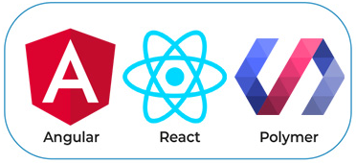

4.2. Progressive web app
Tools to use:
Examples:

Slide 20
5. No Code
No-code hay low-code là gì?
No-code development tức là xây dựng các ứng dụng website, mobile, chatbot, vv bằng các nền tảng hỗ trợ. Với các nền tảng này, bạn không cần biết nhiều về lập trình vẫn làm được. Mình hay gọi là lập trình không cần code.
Một số ví dụ như:
Configure.IT giúp bạn làm mobile app bằng việc drag-and-drop: kéo thả các khối logic, kéo thả phần UI,UX
Bubble.is giúp bạn xây dựng web app, backend cũng bằng việc kéo thả
GlideApps làm mobile app chỉ từ 1 file spreadsheet

Slide 21
5. No Code
Tại sao lại có các nền tảng no-code?
Bạn sẽ thắc mắc là tại sao lại có những nền tảng như thế này?
Thực ra thì những nền tảng no-code này cũng được xây dựng từ những lập trình viên. Có một bí mật mà không phải ai cũng biết là lập trình viên biết lập trình, nhưng đa số không biết lập trình cái gì?
Vì thế họ suy nghĩ, xây dựng các platform no-code này mọi người 'ngoại đạo' - ít kiến thức về IT có thể xây dựng được các apps cho riêng mình.
Nguyên nhân thứ hai là chi phí thuê lập trình viên, freelancer để xây dựng hoàn thiện một ứng dụng cũng khá cao. Thị trường platform no-code cũng khá tiềm năng. Vì thế, mà càng ngày càng có nhiều tool để xây dựng ứng dụng hơn trước.
Notes:
User cũng không quan tâm bạn dùng gì để làm ra app, họ chỉ quan tâm giá trị mà app mang lại cho họ

Slide 22
5. No Code
Tại sao và khi nào nên dùng no-code platform?
Dưới đây là một số lý do bạn nên dùng nền tảng no-code:
Bạn muốn build các internal tool (app nội bộ) cho công ty bạn dùng.
Bạn là solo founder, hoặc co-founder của bạn cũng không làm IT. Việc tìm technical founder không phải là chuyện dễ dàng. No-code platform sẽ giúp bạn tự xây dựng được MVP mà không phải mất thời gian dài để học lập trình.
Bạn chưa chắc chắn về ý tưởng của mình. Bạn cần phát triển MVP nhanh, gọn, rẻ nhất có thể để validate idea, xác định product/market fit.
Bạn cần làm prototype nhanh để đi pitch cho người khác xem ý tưởng của mình. Tự lập trình có thể mất vài tuần, nhưng no-code platform chỉ mất vài ngày, thậm chí vài tiếng.
Bạn không có kinh phí lớn để thuê lập trình viên, freelancer. Một MVP nếu outsource ngoài tầm $1000-$4000. Trong khi với no-code platform, chỉ tốn vài chục đô 1 tháng.

Slide 23
5. No Code
Khi nào không nên dùng no-code platform?
Bạn có nhiều tiền. Bạn có thể quản lý team dev, quản lý dự án thì việc thuê lập trình viên, outsource bên ngoài sẽ tối ưu hơn.
Bạn không muốn học thứ mới. Vì no-code platform không cần lập trình, nhưng vẫn phải hiểu một số nguyên lý logic, UI, UX, design, frontend, backend. Vẫn phải học cách làm để sử dụng tool đó.
Bạn tin chắc rằng dự án sẽ có thêm nhiều tính năng nâng cao trong tương lai. Vì sử dụng các no-code sẽ bị giới hạn về mặt mở rộng tính năng. Nếu bạn tin chắc dự án của mình có thể thành công, thì không nên dùng no-code platform làm gì.
Bạn muốn làm ứng dụng SaaS. Thực ra thì lấy no-code platform như Bubble.is làm SaaS cũng được, nhưng cũng khó mở rộng thêm tính năng.
Notes:
Một số tool no-code mình đã làm review, hướng dẫn rồi. Trong thời gian sắp tới, mình sẽ làm thêm nhiều bài hướng dẫn nữa.
Theo cá nhân mình thì xu hướng no-code, low-code hay visual programming đang phát triển. Rất nhiều tool, nền tảng mới được ra đời giúp builders, makers, founders làm app nhanh và dễ dàng hơn.
Ưu điểm lớn nhất của no-code platform là giúp làm MVP cực nhanh và rẻ giúp bạn xác định product/market fit với chi phí thấp nhất. Nếu bạn đang muốn làm app gì đó, sao không thử với no-code platform xem sao?
một trong những quan điểm sai lầm về nocode là nó có thể thay thế hoàn toàn được cách phát triển phần mềm truyền thống (code).
Nocode sẽ được áp dụng rộng rãi hơn nếu những platform, cộng đồng có đánh giá đúng nhất về khả năng có nó: cái gì làm được và cái gì không.
Ví dụ những loại app mà hiện tại nocode không đáp ứng nổi:
App về Blockchain
Những app có custom design và animation nhiều
Streaming app như Netflix
Video call app
Còn những thứ mà nocode làm cực kỳ tốt:
App nội bộ cho công ty
MVP để validate idea
SaaS kiểu quản lý dữ liệu
Mạng xã hội
Marketplace
Nocode sẽ hiệu quả hơn nếu bạn biết code
Sự thật là nếu bạn không có background IT, bạn vẫn dùng nocode để làm app được, nhưng sẽ tốn thời gian và cần người hướng dẫn nếu muốn tiết kiệm thời gian.
Nhưng nếu bạn có background IT hoặc biết chút ít rồi thì việc xử dụng nocode là dễ dàng.
Ngoài ra, việc mở rộng tính năng qua code cũng là 1 lợi thế của nocode.
Ví dụ bạn muốn viết thêm tính năng giao dịch với Momo thì bạn phải biết cách viết plugin cho Bubble chẳng hạn.
Hiện tại thì đa số các platform nocode cũng có phần plugin để nhà phát triển có thể tự mở rộng thêm các tính năng qua code. Họ có sẵn luôn chợ plugin để dev có thể vào tham gia phát triển các plugin nữa.
Nếu bạn dùng Bubble nhưng muốn tích hợp thêm tính năng thì hoàn toàn có thể thuê người để viết plugin cũng được

Slide 24
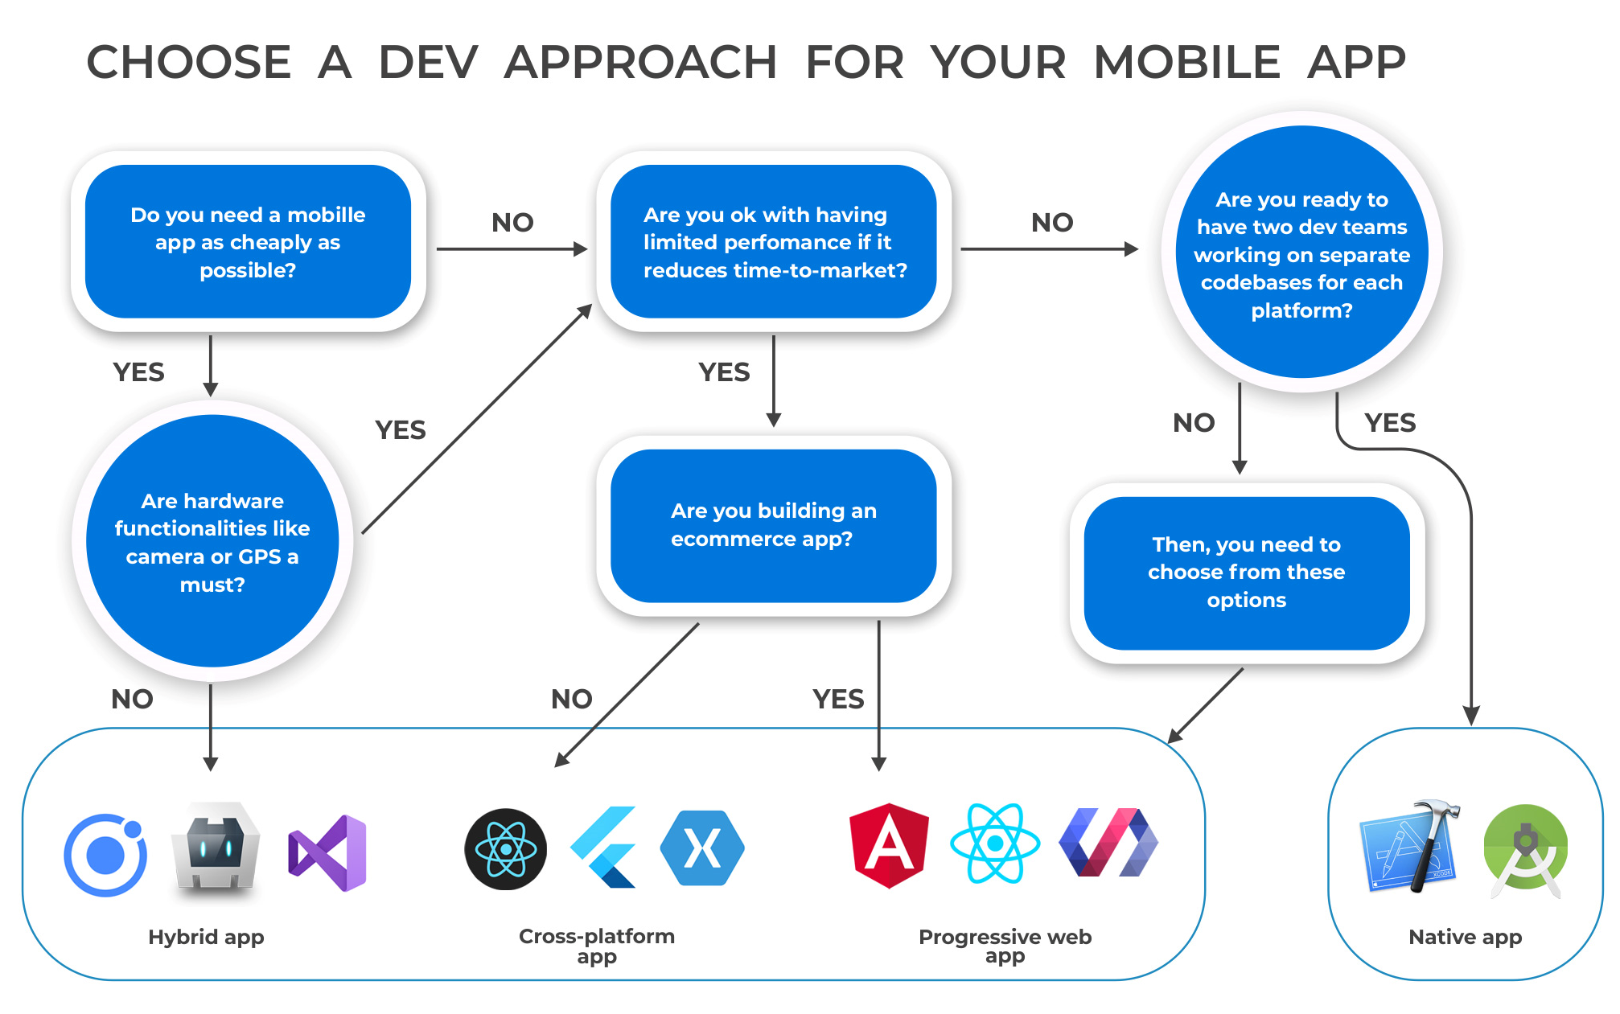
5. Dev approach

Slide 25
6. Comparision table
App type | Native | Hybrid | Cross-platform
Tools | Xcode AppCode Android Studio | Ionic Apache Cordova Visual Studio | React Native Xamarin Flutter
Rendering engine | Native | Browser | Native
Pros | Full access to device’s/OS’s features Powerful performance Native UI (updated along with the OS) Efficient App Running High-quality functionality and UX Access to all native APIs and the platform-specific functionality | Lower development costs Different OS support Code reuse Cost-effective development Big customization capabilities | Different OS support UI performance is almost as fast as native Code reuse Cost-effective development (however, a new language or approach will need to be learned)

Slide 26



6. Comparision table
Libraries | Not much dependency on open-source libraries and platforms | Highly dependent on different libraries and frameworks | Highly dependent on different libraries and frameworks
Examples | Any preset app in your OS Artsy Pinterest | JustWatch NHS Airbus Helicopters | Bloomberg Insightly Reflectly
Ease of development

Slide 27
6. Comparision table
Debugging | Native debugging tools | Native + web development debugging tools | Depends on the framework*
Cons | No multi-platform support High dev costs if different OS support is needed No code reuse | Slower performance Limited access to OS features No interaction with other native apps | Slower performance Limited access to OS features (however, not as limited as for hybrid) Poor interaction with other native apps
Codebase | separate codebases - one per platform | single codebase with potential platform-specific abilities | single codebase with potential platform-specific abilities
Notes:
* Complicated for React Native because there are two layers (and two languages) to go through. You start with JS and then you end up debugging Java code on Android or Swift on iOS. Other cross-platform SDKs like Flutter or Xamarin employ one language – Dart and C# respectively.

Slide 28
7. What to consider when choosing an approach to build a mobile app
Budget
Time to market
Reach (market coverage)
App performance
UI and UX
Functionality
Notes:
Budget
How much money you can spend on a mobile app is fundamental, but it’s not the only metric for choosing a dev approach. When you’re limited in funds, you can’t afford a native app for both iOS and Android. At best, you’ll have to focus on only one platform.
On the other hand, even if the budget is king-sized, it’s not necessary to go native. Your project might benefit from a cheaper app type that will cover your specific needs. For example, your current team consists of JS experts. You can take advantage of this and build a JS-based mobile app with React Native. Otherwise, you’ll have to spend time on hiring experts for two (or more) platform-specific teams.
Time to market
How soon you need an app is also crucial. You should bear in mind that building a native app is quite time-consuming. From this standpoint, hybrids and even PWAs are undisputed winners. And this option is well-targeted if you want to win a race to mobile market over your competitors. However, you’ll have to lower your expectations for performance and UX of the app. Once your product has been marketed, you might consider evolving it into a native app with time, budget permitting.
Reach (market coverage)
For now, we have the two largest markets of mobile apps. And most product owners prefer to have their apps available on both of them. In this context, cross-platform or hybrid app development is a winning approach. They let you clear your mind of additional load associated with multiple platforms. You’ve got one team that works on the app that can run on both iOS and Android. With native, you’ll have more pains.
App performance
Airbnb’s example can be instructive here. This company was one of the first adopters of React Native. They chose the cross-platform method to move faster as an organization and to only have to write product code once. Two years later, their priorities changed. Airbnb set its sights on higher app performance and better dev experience. Hence, now they’re putting all of their efforts into making native amazing.
What we can learn from Airbnb is that you can benefit from different dev approaches at a particular time. They were satisfied with React Native at the outset of their journey to mobile. However, growing ambitions and objectives pushed them to go native. That was not a mistake but a fruitful experience. As for hybrid app performance in general, here is what Zuckerberg thinks:
The biggest mistake we’ve made as a company is betting on HTML5 as opposed to native
Perhaps, this was one of the inspirations for creating React Native.
UI and UX
According to Statista, the retention rate of mobile app users is 38% in 2018. It means that nearly one in three people abandon mobile apps after the first experience. That’s why the impression your product provides is crucial. Native apps are headliners in UI and UX. Users get better scrolling, dynamic animations, and other appealing elements. And these are wrapped in a performant product.
If we compare cross-platform development vs. native development, the former lags behind. But still, the UX you can get with Flutter or React Native is much better than with any hybrid framework. We’ve blogged about it in Ionic vs. React Native.
Functionality
Do you want your users to enjoy functionalities linked to a device’s utilities? These are the camera, various sensors, and so on. If you do, keep in mind that hybrid apps cannot implement them to the fullest extent. Cross-platform apps are less limited than hybrids. Still, it’s possible to develop 95% of the app using React Native, and the remaining 5% with native technology. The native code implements some sensors whenever you need them to the fullest extent. The native dev approach has no restrictions in this regard.

Slide 29
7. So, what’s your choice?
Build a native app
Build a hybrid app
Build a cross-platform app
Notes:
Build a native app
Native dev approach is definitely a king. It provides you with unlimited area for development. The native app is unlikely to frustrate the UX expectations of your users. And your engineers will enjoy working at this project.
But be prepared for your dev team to increase almost twofold. So will the costs. And do not expect a fast TTM unless your developers are supermen:)
Build a hybrid app
What a hybrid approach can attract with is low price and high dev speed. So, an ambitious startup can benefit from building a hybrid app as a pilot solution. It is the best option if you do not think much of UX and performance. These factors, however, might scare off demanding users.
Build a cross-platform app
Think of cross-platform as a golden mean between the above options. It is not as cheap as hybrid but cheaper than native. The app performance is on a good level. There are some use cases that claim they managed to achieve native performance, but these are perhaps… less than honest:) TTM? Perhaps, the difference between native and cross-platform development for dev speed is not huge. But, if you opt for a cross-platform framework, you’ll win in terms of cost and time-efficiency.

Slide 30


Questions?

